Slide 1
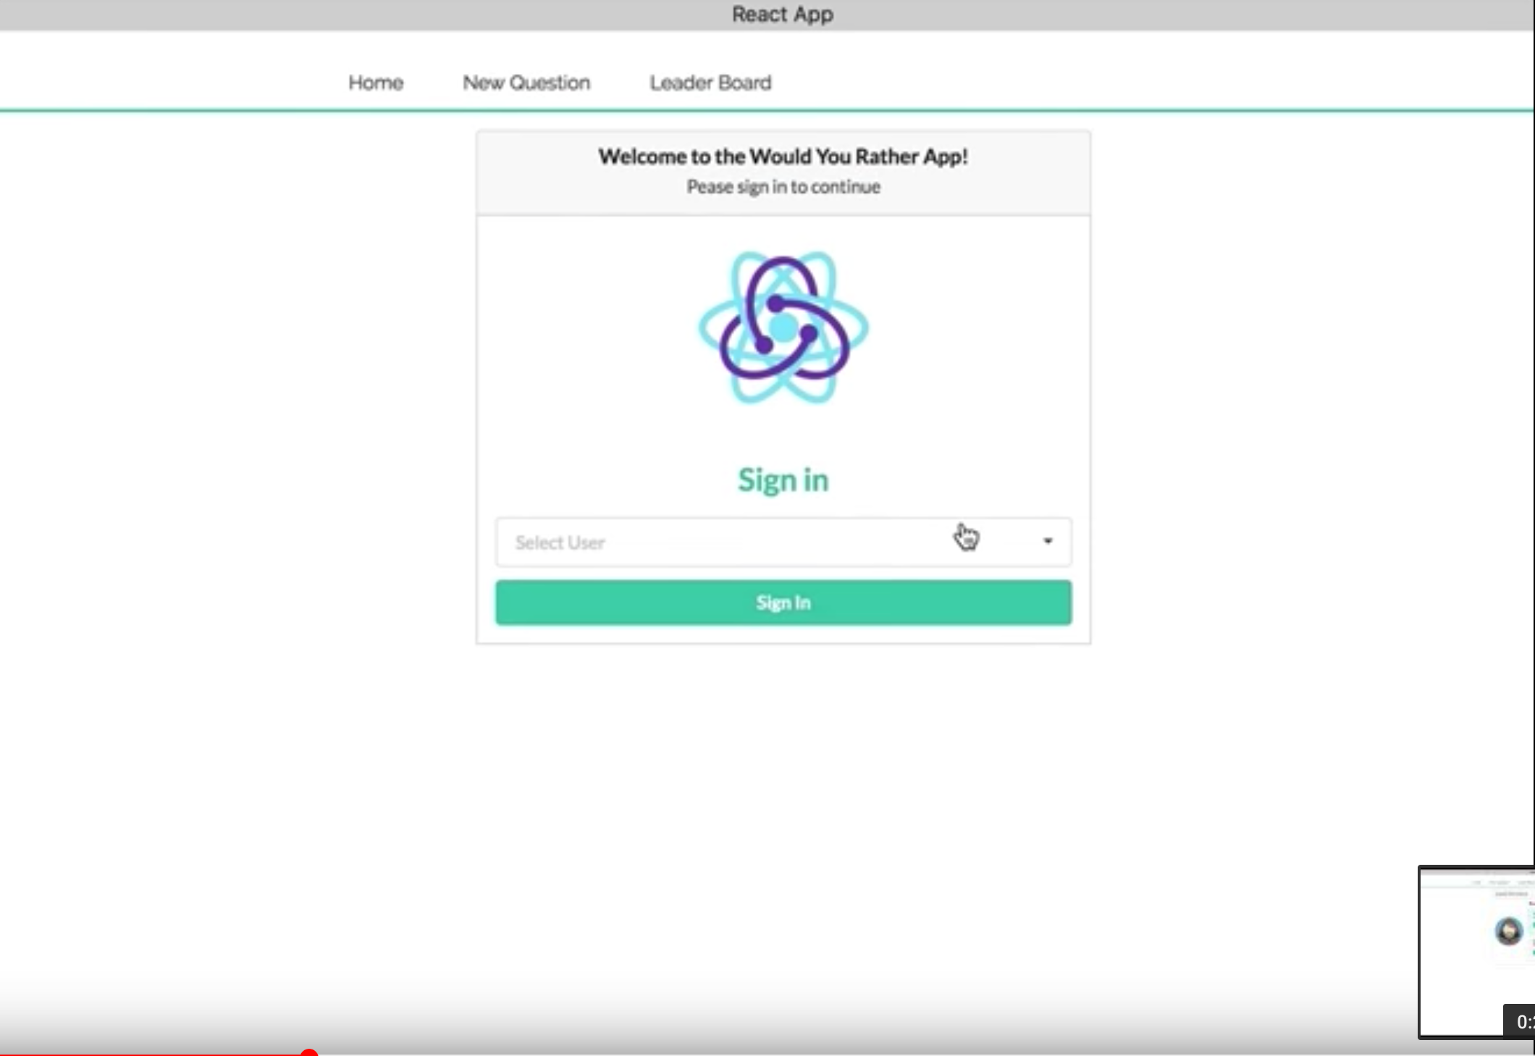
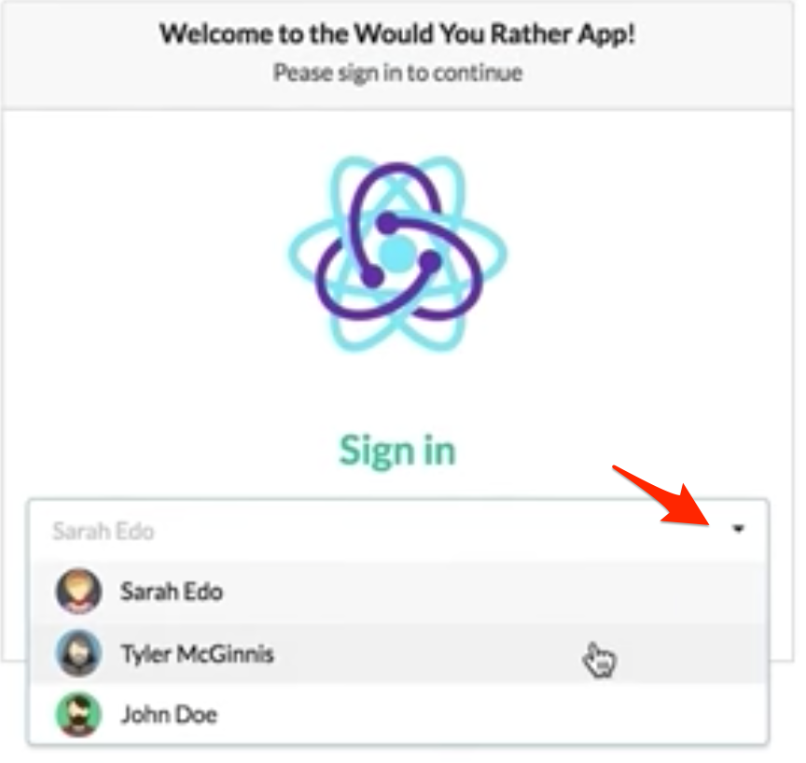
Login component
Initial list of user loaded

Slide 2
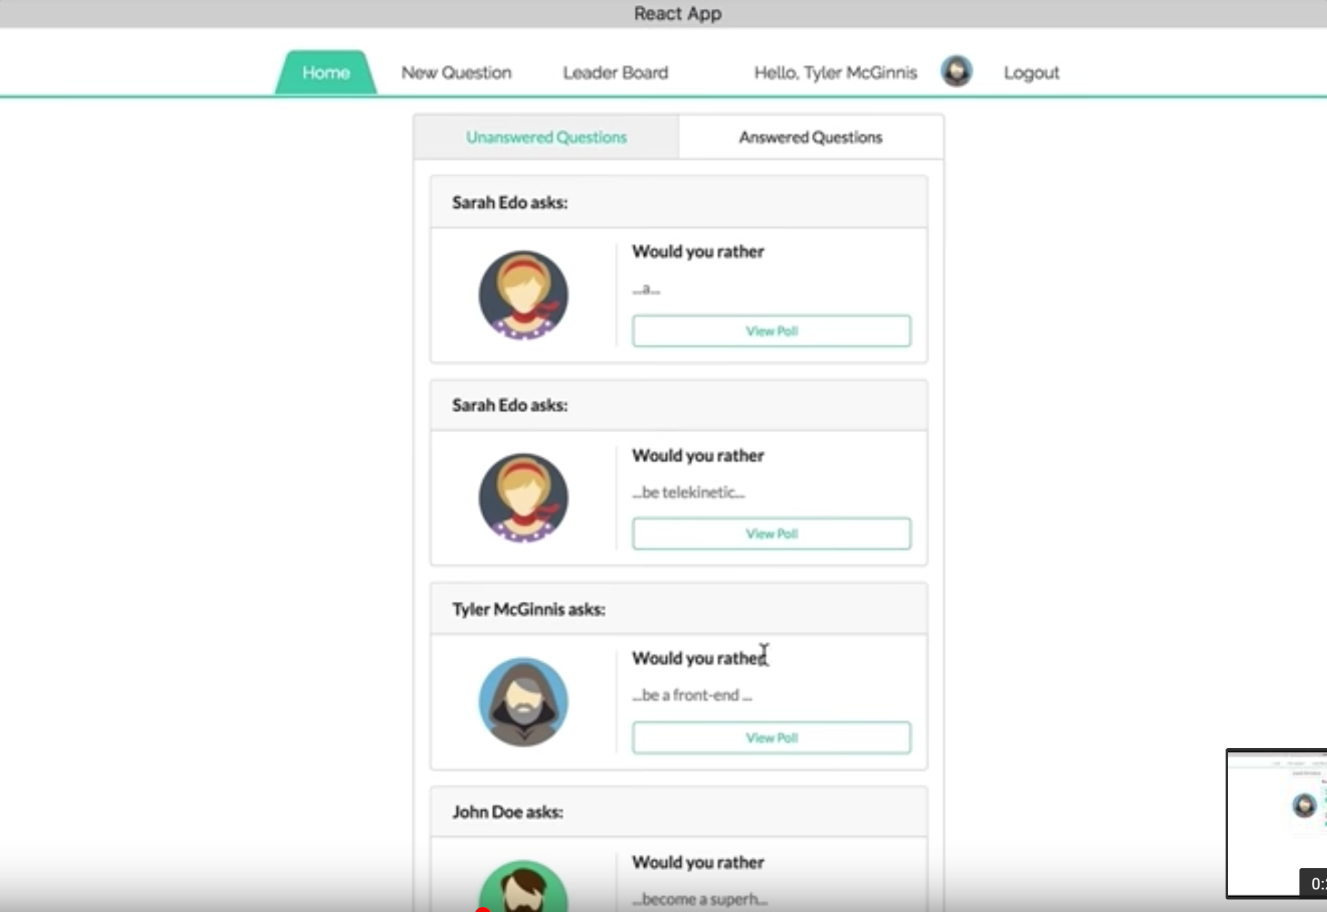
QuestionsBoard component
Click to show 3rd slide
Question component
Picture component

Slide 3
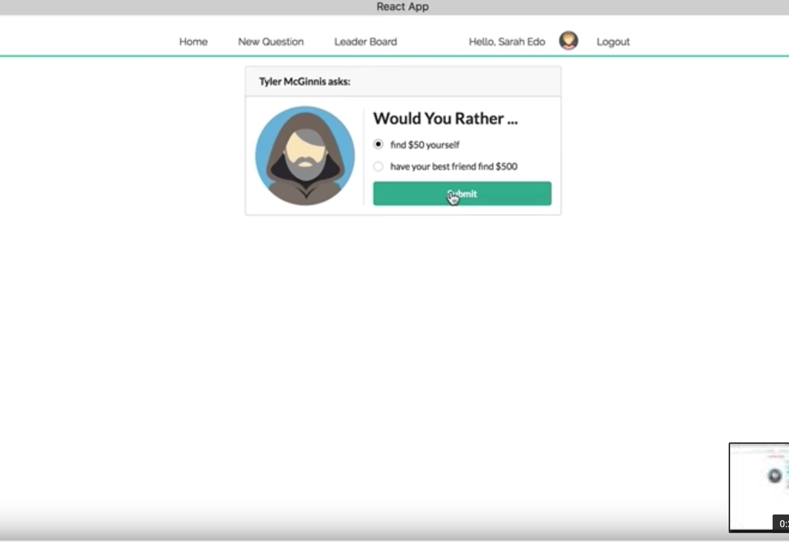
Poll component
This view is shown when click on “View Poll” button from Home view
Click to show 4th slide

Slide 4
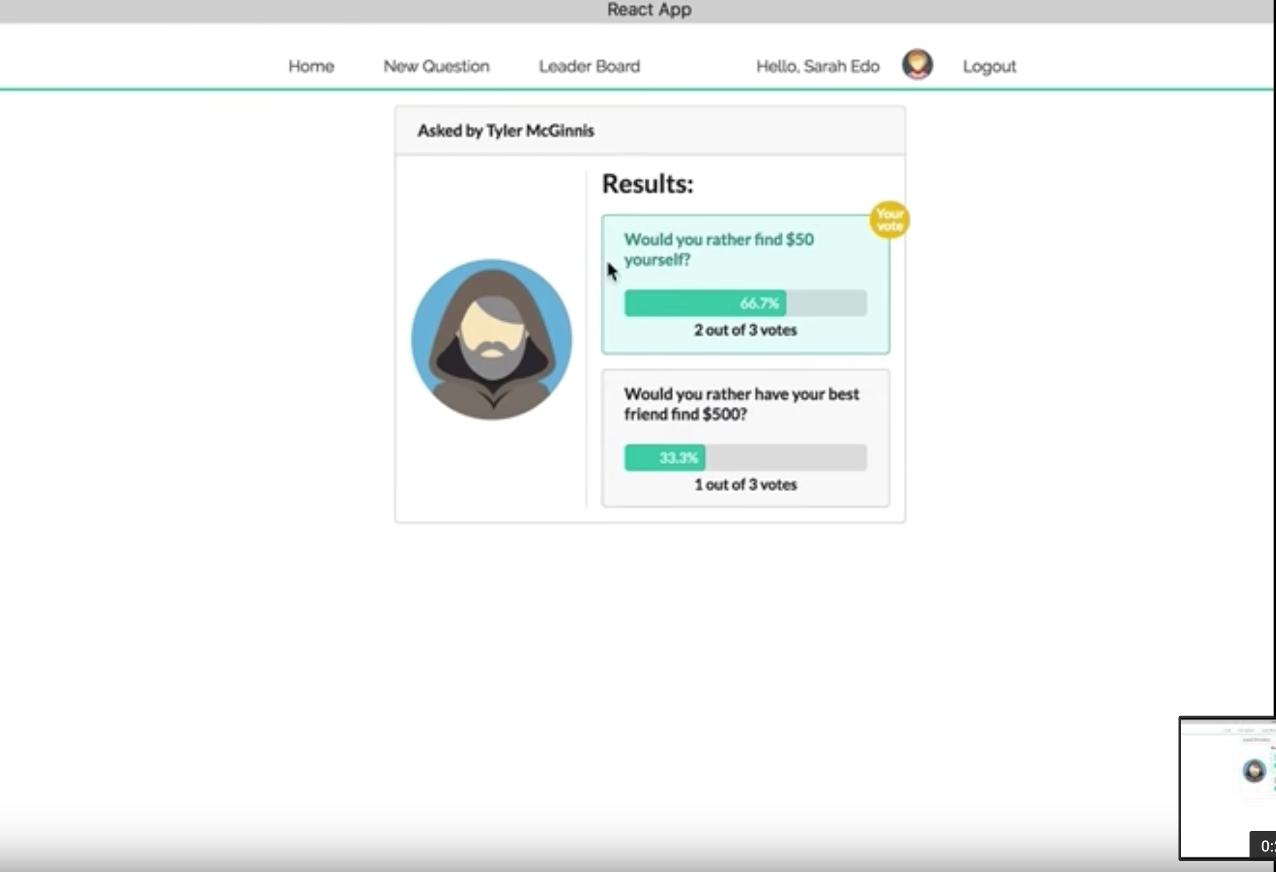
Results component
This view is shown when click on “Submit” button from previous slide

Slide 5
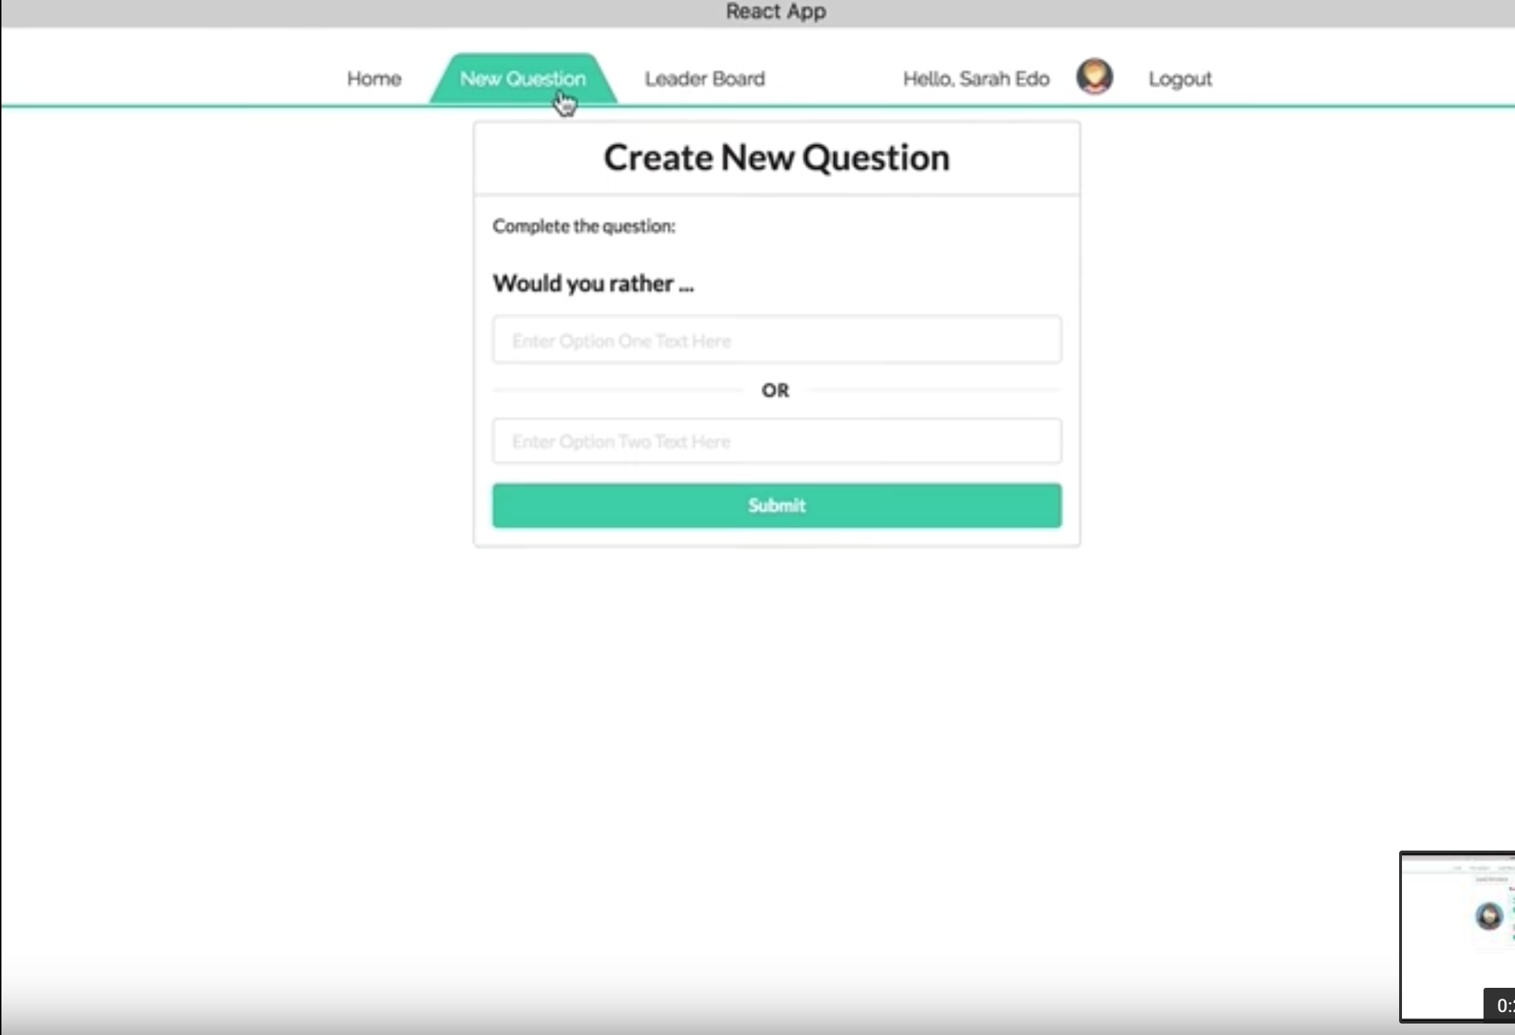
NewQuestion component

Slide 6
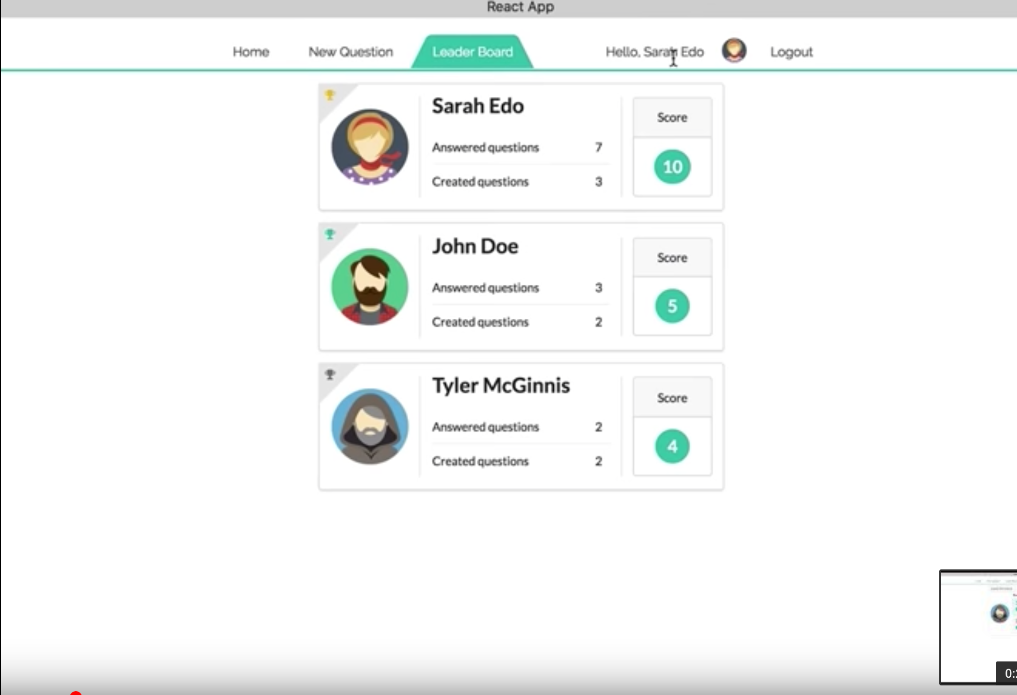
Score component
CardBoard component

Slide 7
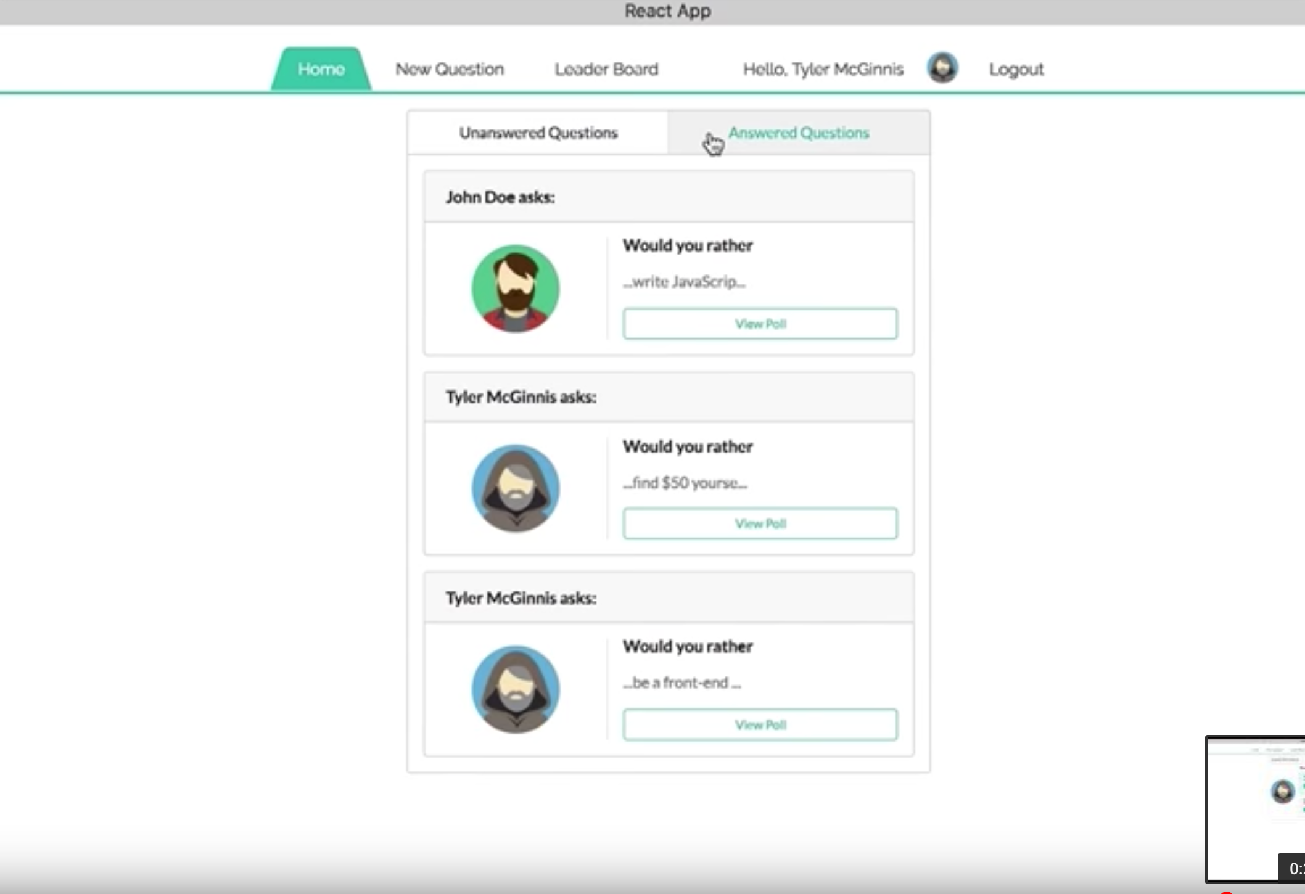
QuestionList component

Slide 8
Paths
‘/’
‘/home’
‘/poll’
‘/newquestion’
‘/results’
‘/leaderboard’
Components
Nav
Login
CreateQuestion
Results
Home
LeaderBoard
CardBoard
NewQuestion
Question
QuestionBoard
QuestionList
Score
Poll
Picture

Slide 9
Actions and Events
LOGIN (SET_AUTHED_USER)
ADD_QUESTION
ANSWER_QUESTION
RECEIVE_USERS
RECEIVE_QUESTIONS
Components
Nav
Login
CreateQuestion
Results
Home
LeaderBoard
CardBoard
NewQuestion
Question
QuestionBoard
QuestionList
Score
Poll
Picture

